Slide 1
Franklin Junction
Notes:
Lexzy 1-4

Slide 2
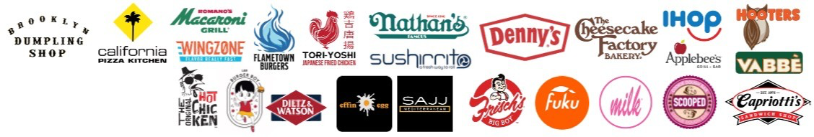

Executive Summary
Research Question: What key initiatives, strategies, and processes were effective or ineffective in 2023, 2024, and did those trends continue into early 2025?
Our Investigation: Analyzed 3 years of store-level revenue data (2023-2025), revenue performance segmented by demographic income bands, and month-by-month expansion velocity and unit economics.
How we analyzed it:
Comparative analysis across years
Per-store revenue as primary performance metric
Income band segmentation to understand targeting effectiveness
Trend analysis to identify what strategies worked vs. failed

Slide 3
Data Overview
Dataset Summary
Three Years of Performance Data:
2023: 81 stores (12 months complete)
2024: 128 stores (12 months complete)
2025: 180 stores (5 months – Jan through May)
Key Metrics Tracked:
Total stores and revenue by year
Revenue per store (unit economics)
Store distribution by income demographics
Monthly performance trends
Income Band Classifications:
120k+: Median household income $120,000+
80k-119k: Median household income $80,000-119,000
50k-79k: Median household income $50,000-79,000
<50k: Median household income under $50,000
Unknown: Stores without demographic data
Critical Note on 2025 Data
2025 represents only 5 months (Jan-May). All 2025 comparisons are annualized projections based on current pace. Recommendations account for data limitations.

Slide 4
Data Cleaning
How we cleaned the data:
Consolidated all 2023–2025 data into a single store × month unified model to support consistent year-over-year comparison.
Standardized schemas (year, month, brand, platform, location) and resolved missing or inconsistent values across all source tables.
Recomputed core KPIs — revenue, orders, avg ticket, revenue per store — using a uniform logic across all years.
Integrated ACS income-band data and corrected store mappings to enable demographic and regional diagnostics.
Fully validated totals against the system “golden truth,” ensuring a clean, reliable dataset for analyzing 2024 performance and early 2025 trends.
Removed Frisch’s Big Boy’s from all datasets

Slide 5
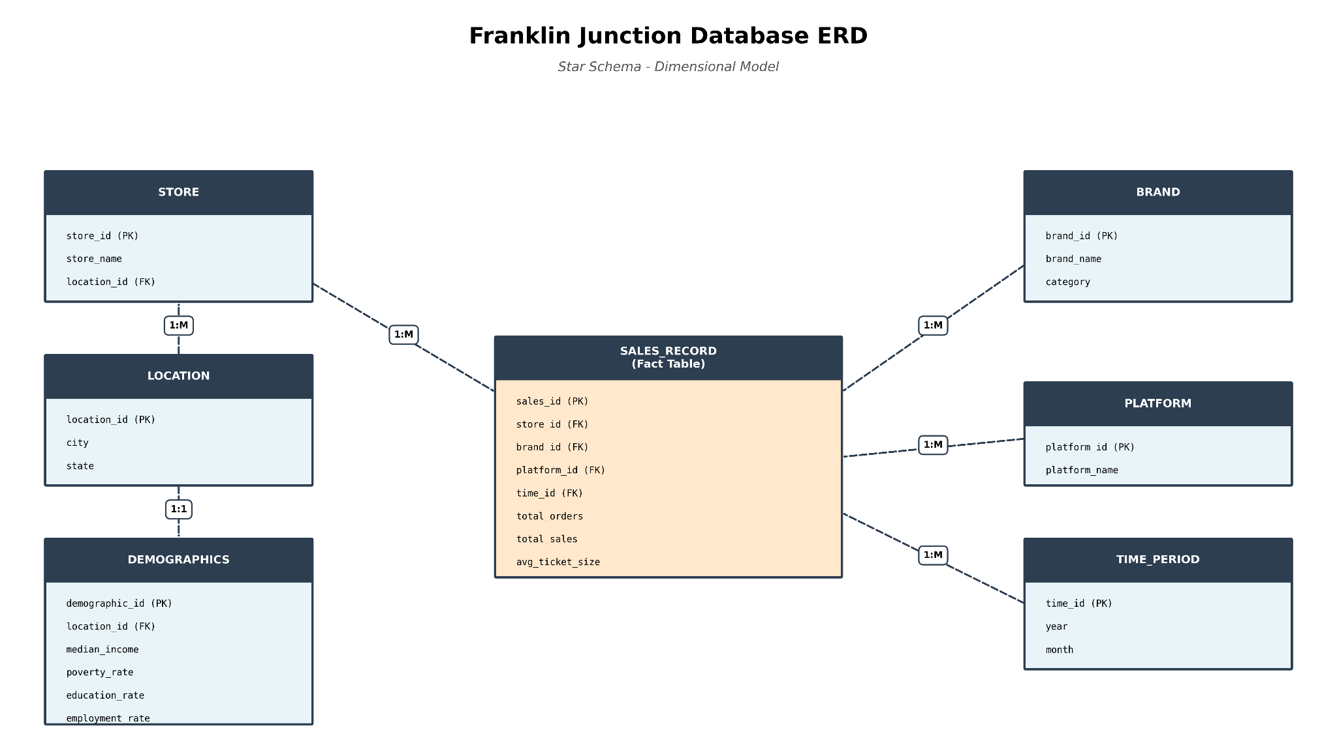
ERD Diagram
2025 Data (Jan-May)
The central SALES_RECORD table connects to six dimension tables: Store, Brand, Platform, Time, Location, and Demographics.
This structure enables efficient querying across any business dimension, supporting the revenue analysis, brand comparisons, and geographic insights presented today.
Notes:
Alex 5-12

Slide 6
2023 Baseline Performance
The Foundation Year
Scale:
81 stores in operation
$1,526,419 total revenue
$18,845 avg per-store revenue
Income Band Distribution (2023):
Income Band | Stores | Total Revenue | Per-Store Revenue
120k+ | 3 | $321,563 | $107,188
80k-119k | 15 | $241,955 | $16,130
50k-79k | 21 | $492,811 | $23,467
<50k | 8 | $98,643 | $12,330
Unknown | 36 | $371,447 | $10,318
Unknown stores problem: 36 stores (44% of total) without demographic data—early warning sign of flying blind

Slide 7
2024 - Performance
Scale:
128 stores in operation (+58% growth)
$4,157,568 total revenue (+172%!)
$32,481 avg per-store revenue (+72%!)
Income Band Distribution (2024):
Income Band | Stores | Total Revenue | Per-Store Revenue
120k+ | 7 | $388,940 | $55,563
80k-119k | 22 | $1,287,957 | $58,543
50k-79k | 31 | $1,034,767 | $33,380
<50k | 11 | $609,626 | $55,421
Unknown | 60 | $836,278 | $13,938
Unknown stores problem: 60 stores (47% of total) without demographic data—early warning sign of flying blind

Slide 8
2025 - Performance Thus Far…
Scale:
180 stores in operation (+41% in 5 months!)
$2,336,801 actual revenue (5 months YTD)
$5,608,323 projected revenue (annualized, +35%)
$31,157 avg per-store revenue (projected, -4%)
Income Band Distribution (2025):
Income Band | Stores | Total Revenue | Per-Store Revenue | Vs 2024
120k+ | 14 | $354,488 | $10,526 | -81%
80k-119k | 31 | $1,463,945 | $19,661 | -66%
50k-79k | 35 | $1,542,226 | $18,360 | -45%
<50k | 16 | $887,462 | $23,111 | -58%
Unknown | 84 | $1,360,202 | $6,757 | -52%
Unknown stores problem: 84 stores (47% of total) without demographic data—early warning sign of flying blind.

Slide 9
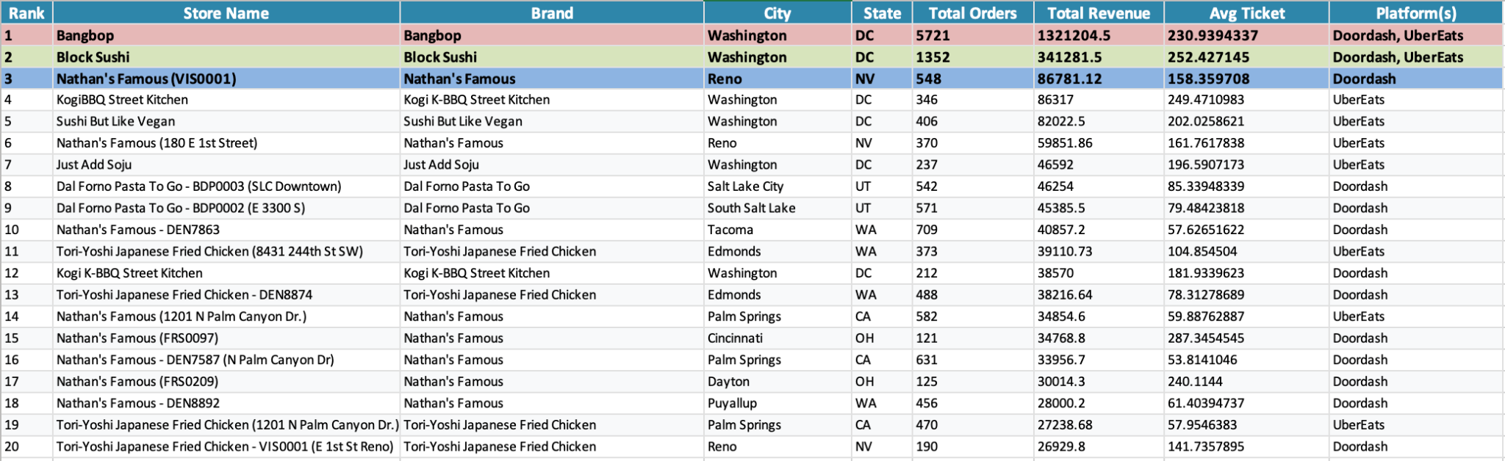
Exploratory Analysis - Top 20 Performing Stores (All Platforms)

Slide 10
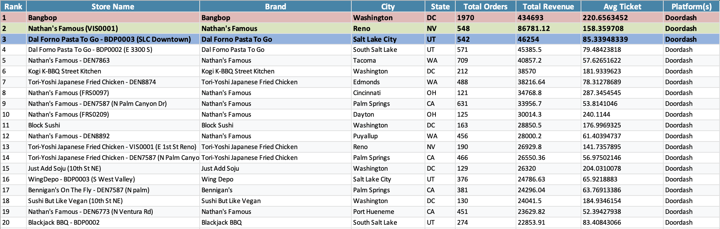
Exploratory Analysis - Top 20 Doordash Stores

Slide 11
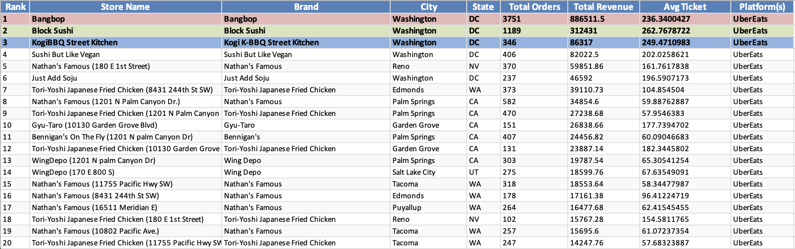
Exploratory Analysis - Top 20 Ubereats Stores

Slide 12
Exploratory Analysis - Characteristics of Top-Performing Stores
Key Patterns in Top 20:
Geographic Concentration:
Washington DC dominates (Bangbop, Block Sushi, KogiBBQ Street Kitchen)
Reno, NV strong (Nathan's Famous locations)
Salt Lake City, UT emerging (Dal Forno Pasta)
Brand Performance:
Bangbop: #1 overall ($1.32M revenue, $231 avg ticket)
Nathan's Famous: Multiple locations in top 20
Dal Forno Pasta: Specialty brand showing strong results
Tori-Yoshi: Consistent performer across markets
Platform Mix:
Top stores often perform on both platforms
High average ticket sizes ($150-250) common
Order volume + ticket size both important
Strategic Implication: Replicate the DC/Reno model, don't just add stores anywhere

Slide 13
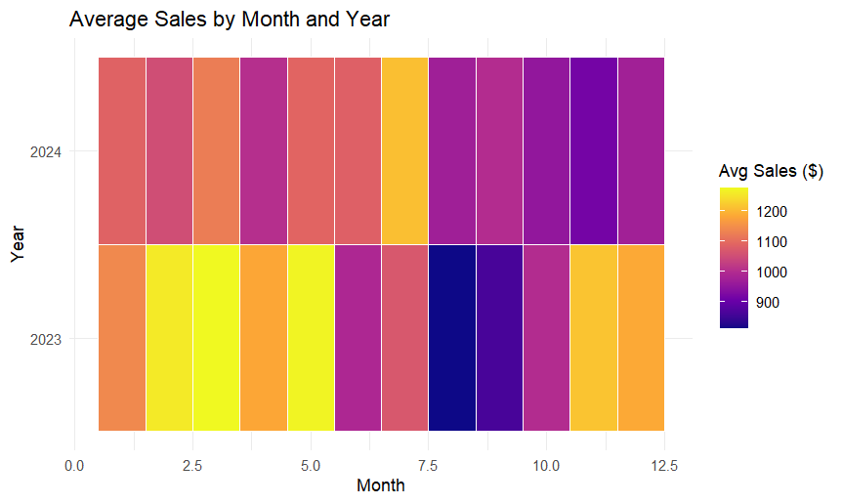
Avg Performance Per Store-Month: 2023 vs 2024
2023 Patterns:
Variable performance month-to-month
More high-performing months (yellow = $1200+)
Some low-performing months (purple/dark = $900)
2024 Patterns:
Mainly falls into the purple band ($900-1000 range)
Fewer extreme highs
Notes:
Dylan 13-22

Slide 14
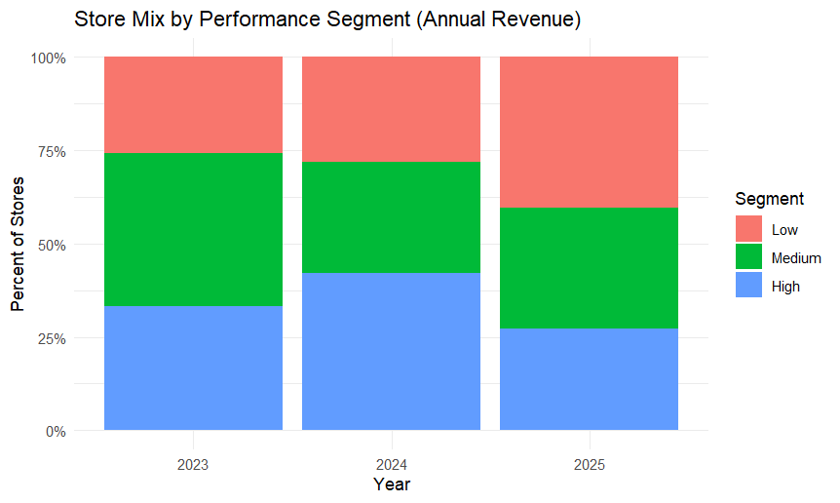
Store Mix by Performance Segment
2023 Distribution:
Reasonable mix for baseline year
2024 Distribution:
~45% High, ~30% Medium, ~25% Low
More high performers
2025 Distribution:
~28% High, ~35% Medium, ~37% Low
High performers shrank, low performers grew
Portfolio quality declining
New stores pulling average down
Critical Insight: 2025's expansion added more low performers than high performers; expansion velocity exceeded execution capacity

Slide 15
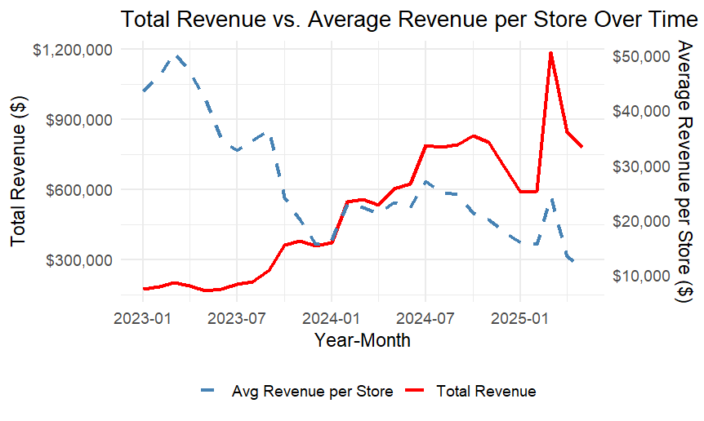
Total Revenue vs Average Revenue
2024:
BOTH lines trending up together
Total revenue growing AND per-store improving
This is sustainable, profitable growth
2025:
Red line spikes (total revenue hits $1.2M in one month)
Blue line crashes (per-store drops below $20K)
Over-expansion pattern: Adding stores faster than they can perform

Slide 16
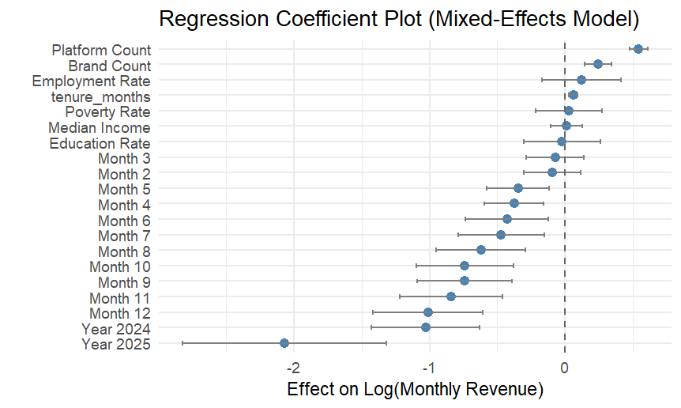
Regression Results
Platform & Brand Diversity Matters:
More platforms and brands per store = positive revenue impact
Diversification reduces risk and captures more customers
Demographics Drive Performance:
Employment rate: Positive impact
Median income: Positive impact
Education rate: Positive impact
Poverty rate: Positive impact
Actionable Insight: Target areas with high employment, education, and median income for new stores

Slide 17
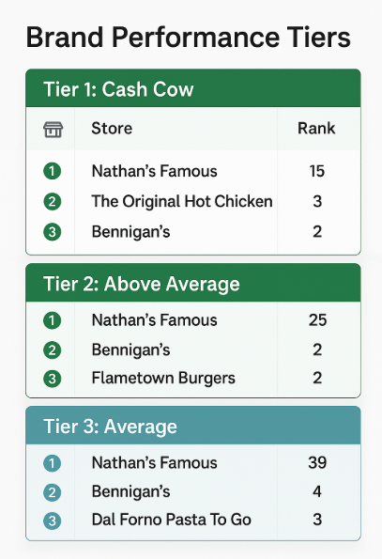
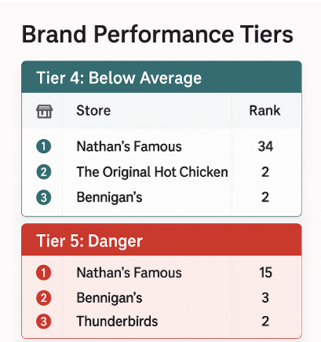
Brand Performance
Tier 1: Cash Cow
Top 10% of stores (highest performers)
Nathan’s Famous (15 locations)
These are the stores to replicate
Tier 2: Above Average
75th-90th percentile - Strong performers
Nathan's Famous (25 locations) - most versatile brand
Tier 3: Average
50th-75th percentile - Middle of the pack
Nathan's Famous still leading (39 locations)
Meeting expectations but room for improvement
Tier 4: Below Average
25th-50th percentile - Struggling stores
Nathan's Famous (34 locations) - even good brands can have bad locations
The Original Hot Chicken (2 locations)
Bennigan's (2 locations)
Need immediate attention or closure consideration
Tier 5: Danger
Bottom 25% of stores - serious underperformers
Nathan's Famous (15 locations)
Bennigan's (3 locations)
Thunderbirds (2 locations)
Prime candidates for closure

Slide 18
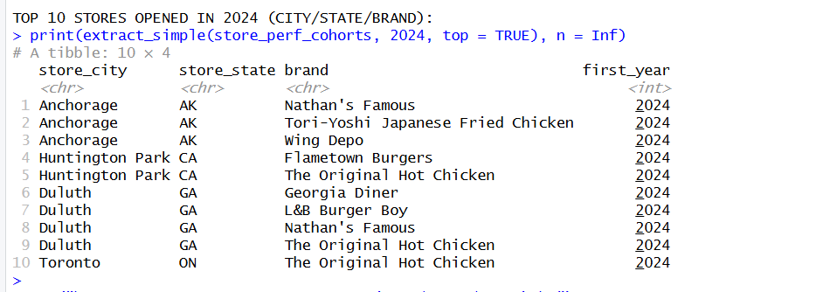
Top 10 Stores Opened In 2024

Slide 19
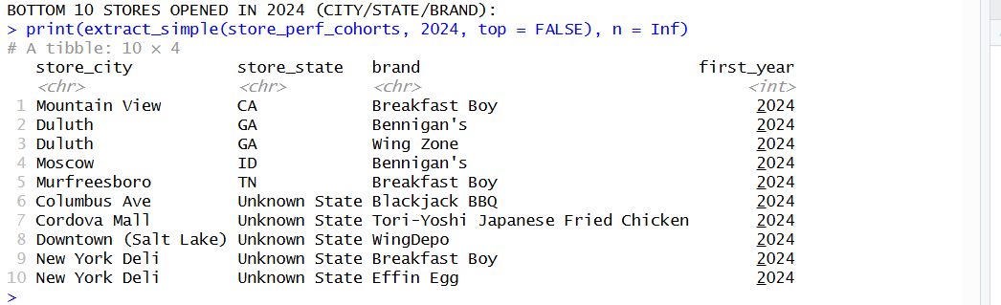
Bottom 10 Stores Opened in 2024

Slide 20
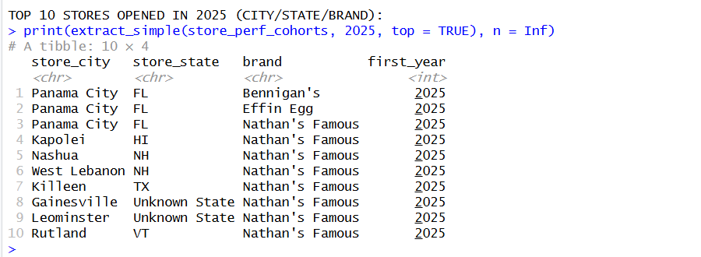
Top 10 Stores Opened in 2025

Slide 21
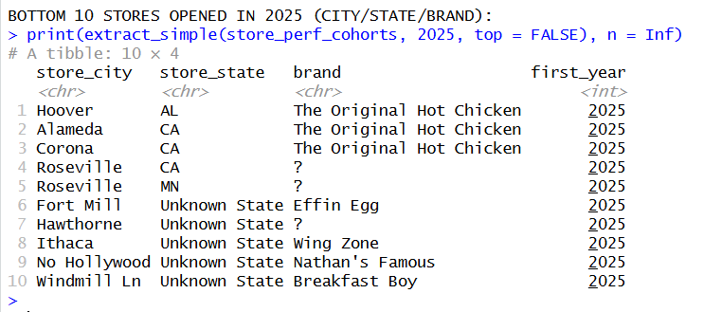
Bottom 10 Stores Opened in 2025

Slide 22
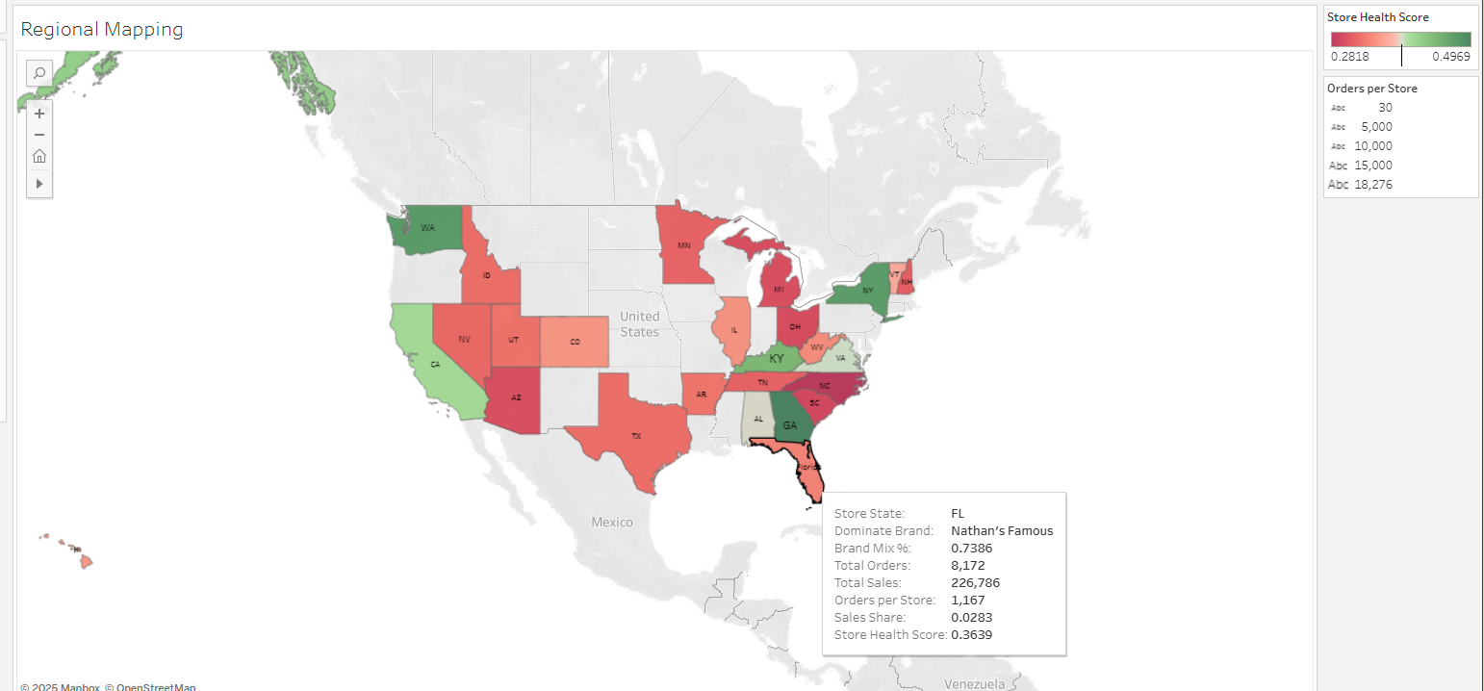
Tableau Dashboard Demo

Slide 23
Insights & Recommendations
Recommendation #1: Expansion Freeze
Action: Stop all new store openings for 6 months
Rationale: Cannot fix quality while adding complexity
Target: Focus on stabilizing per-store revenue at $28k+/month minimum
Recommendation #2: Target Specific Demographics
Action: Focus exclusively on 80k-119k income band
Rationale: This segment generated $58,543/store in 2024 (86% above average)
Target: 50%+ of portfolio in 80k-119k within 12 months
Recommendation #3: Close Bottom Performers
Action: Exit lowest 15-20 stores (likely the 2025 additions)
Rationale: Poor performers consume resources and drag averages down
Target: Raise company average per-store to $35K+
Recommendation #4: Obtain Demographic Data
Action: Get income data for all 84+ "Unknown" stores
Rationale: Can't optimize what you don't measure
Target: Zero "Unknown" stores within 3 months
Notes:
Lexzy 23-25

Slide 24

Thank you!

