Slide 1
E Commerce Traffic/Revenue
By Dylan Conde

Slide 2
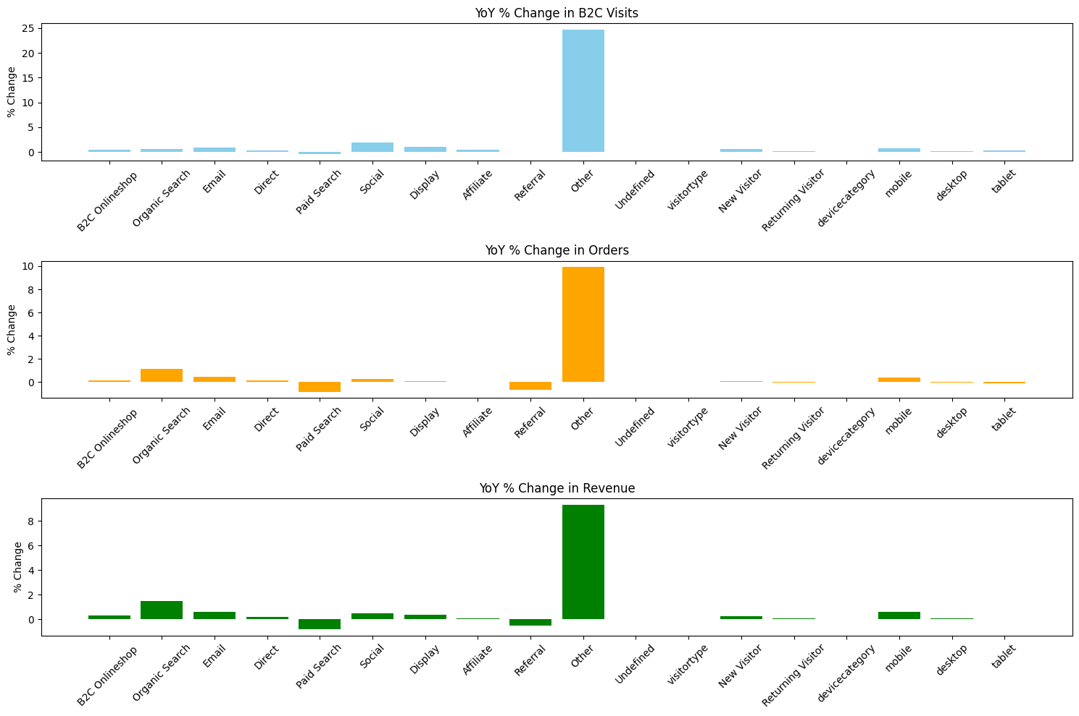
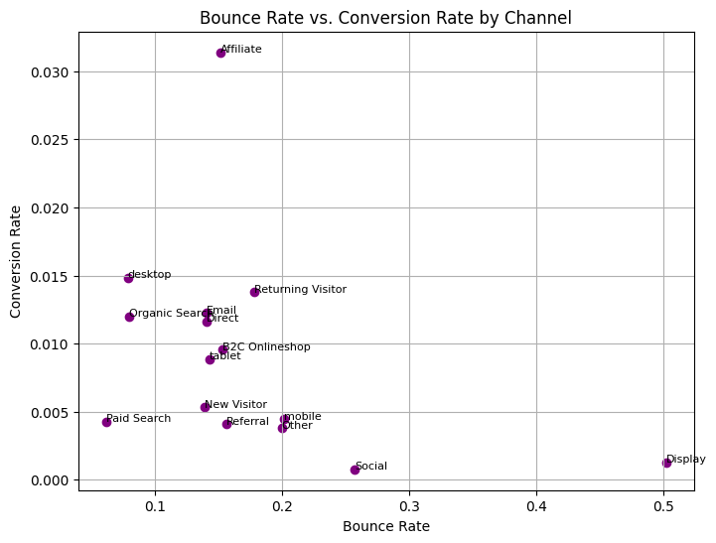
Year over Year Development of Traffic and Revenue
Date
01
Organic Search - Top performer; high efficiency in conversions and revenue lift
Other - Explosive growth from low base; monitor for sustainability as CR is low (0.38%).
02
High performers - Affiliate stands out with the highest CR (~0.031) and moderate BR (~0.15), indicating efficient conversions.
Points generally show an inverse relationship—lower bounce rates correlate with higher conversion rates, highlighting opportunities for optimization in high-bounce segments.

Slide 3
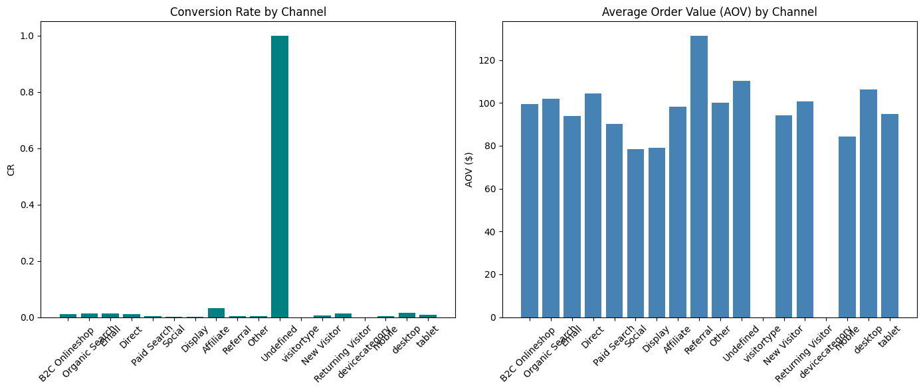
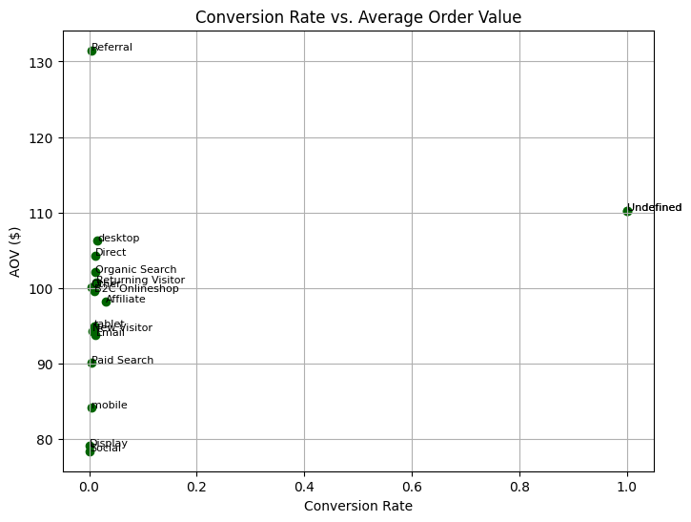
Year over Year Development of Traffic and Revenue
​​
01
By Channel - Organic Search leads (+150% revenue); Paid Search lags (-81%).
annel: Organic Search leads (+150% revenue); Paid Search lags (-81%).
Mobile grows fastest (+68% visits) but lowest CR; Desktop highest value.
annel: Organic Search leads (+150% revenue); Paid Search lags (-81%).
02

Slide 4
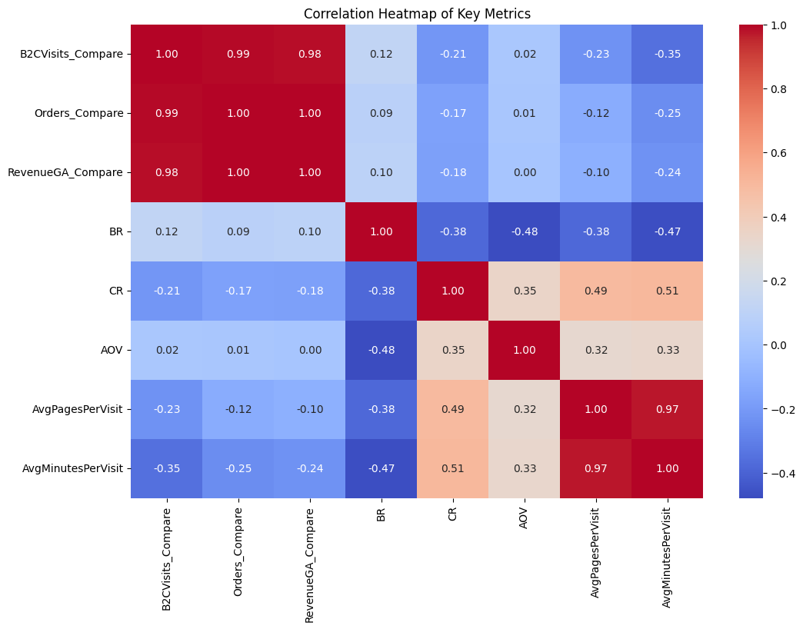
Year over Year Development of Traffic and Revenue
​​
Strong positive correlations (blue, ~0.8-1.0): Between traffic metrics (e.g., B2CQualVisits and B2CVisits ~1.0)
Negative correlations (red, ~-0.5 to -1.0): Bounce Rate (BR)
01

Slide 5
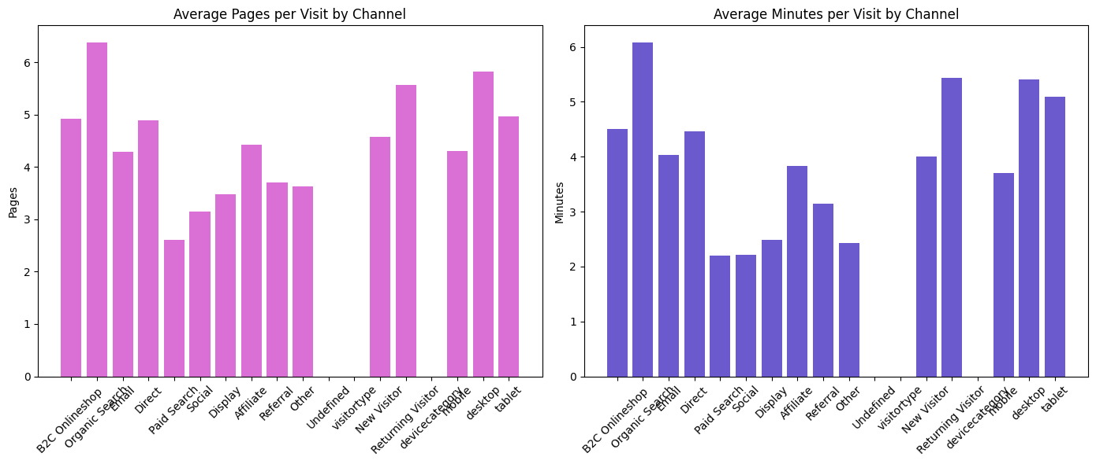
Year over Year Development of Traffic and Revenue
​​
Highest - Organic Search (~6.4 pages), indicating deep engagement from search users.
Lowest - Paid Search (~2.6 pages), suggesting quick exits or less relevant traffic.
02

Slide 6
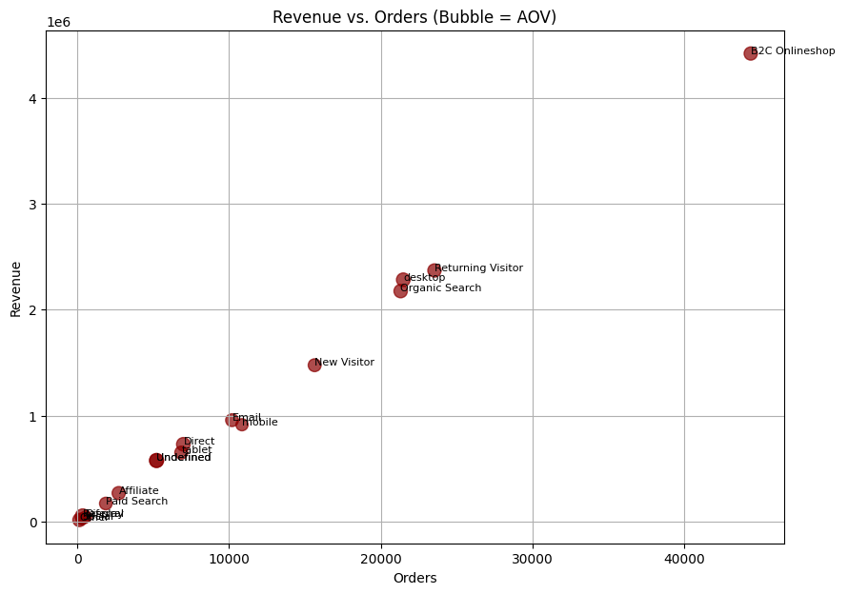
Year over Year Development of Traffic and Revenue
​​
Points show a positive linear trend, with AOV (Average Order Value) implied by the slope (revenue per order)
Channels that convert better tend to have slightly lower average order value, possibly due to promotions or entry-level purchases
03

